Slide 1
Computational analysis of single-cell RNA-seq data: Challenges and opportunities
Stefanie Warnat-Herresthal, Joana Bernardes, Jonas Schulte-Schrepping

Slide 2
Timeline
Presentation: Introduction (15 min)
- Hands on: Data inspection (Count Matrix, Present Gene Types, highest expressed genes and gene families) (20 min)
2. Presentation: Seurat Start (10 min)
- Hands on: Initialization of Seurat Object, Filtering, Normalization, Variable Gene Selection, Scaling (30 min)
3. Presentation: Dimensionality Reduction (10 min)
- Hands on: PCA and tSNE (30 min)
4. Presentation: Clustering + Marker detection (10 min)
Hands on (30 min)
5. Advanced tasks (25 min)

Slide 3
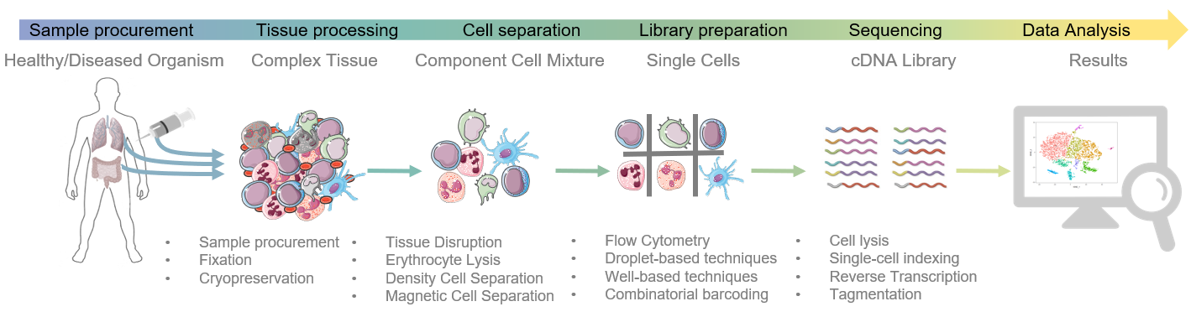
Single-cell RNA-seq experiments are highly complex

Slide 4
3’ vs full length libraries
mRNA
polyA tail
Cell-specific barcode
Transcript-specific barcode (UMI)
polyT primer
cDNA sequence
3’-targeted library
Full length library
e.g. DropSeq, SeqWell, 10x
Less sensitive (more dropouts)
Higher throughput
Allows more accurate quantification of transcript numbers
e.g. smartSeq2
More sensitive
Less throughput
Allows for isoform detection

Slide 5
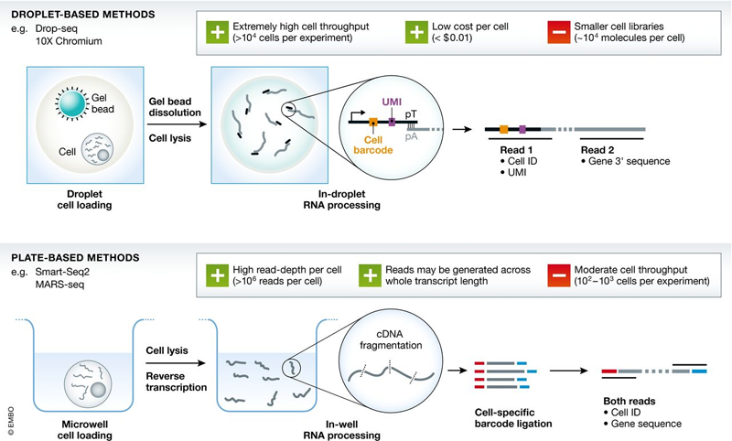
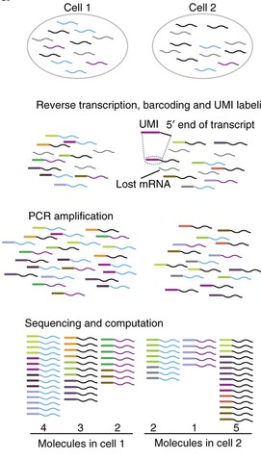
UMI – unique molecular identifier
Griffiths JA, Scialdone A, Marioni JC. (2018) Using single-cell genomics to understand developmental processes and cell fate decisions. Mol Syst Biol 14(4):e8046.
https://cgatoxford.wordpress.com/2015/08/14/unique-molecular-identifiers-the-problem-the-solution-and-the-proof/

Slide 6
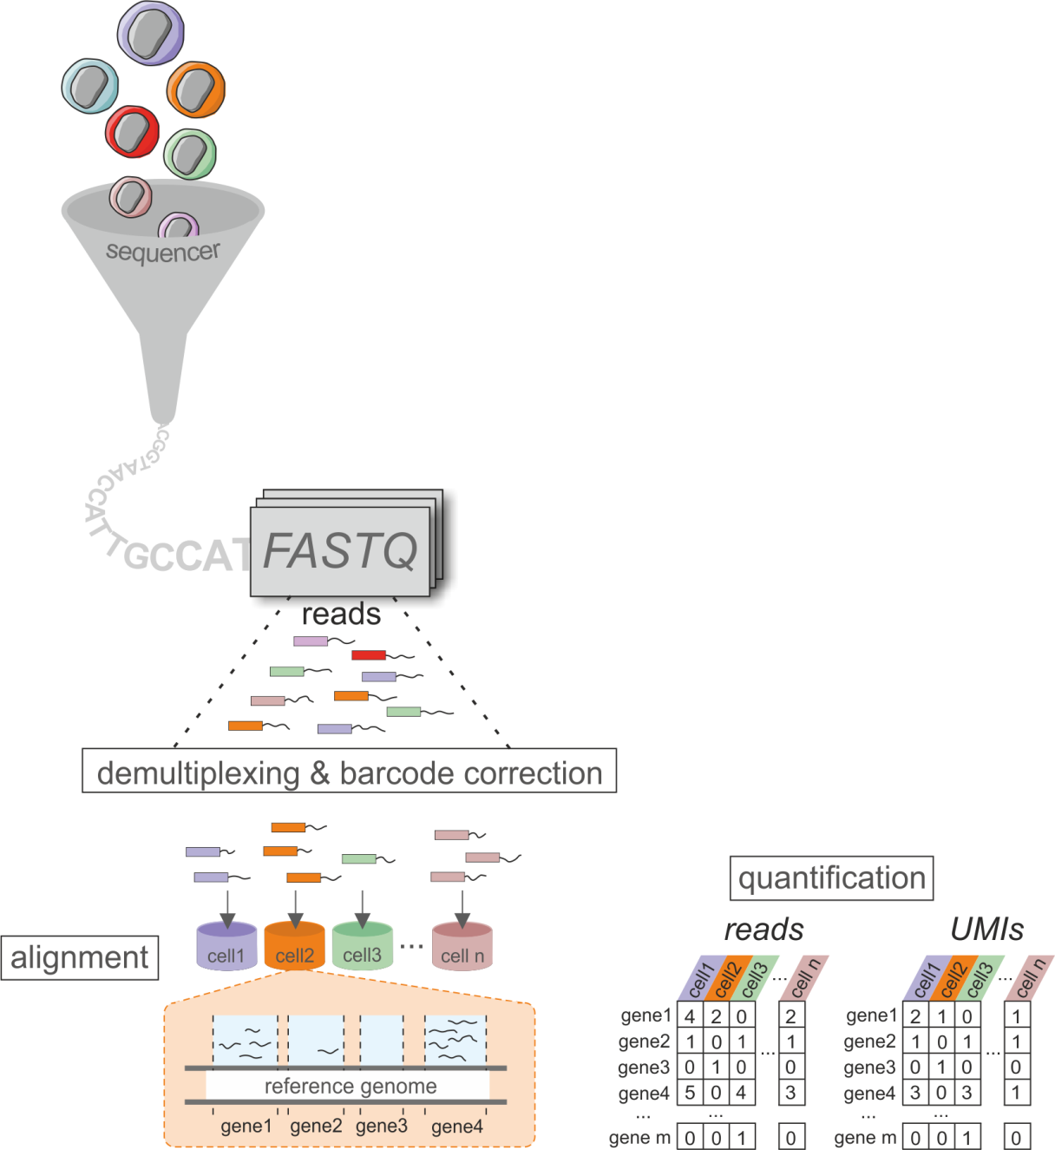
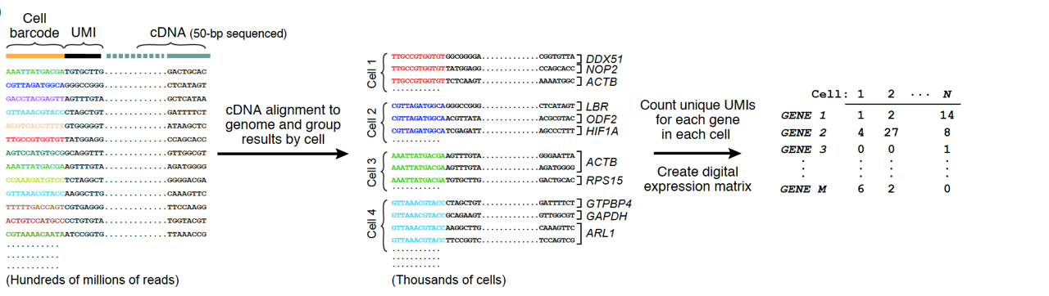
Standard data processing workflow
Complete pre-processing workflows, such as Cellranger (10X) or
dropseq tools (http://mccarrolllab.org/dropseq/) perform:
Bcl2 to FASTQ conversion including library demultiplexing
In e.g. SS2 each library corresponds to a single cell
FASTQ Quality Control (!)
For 3’ techniques: Read Demultiplexing for single cells
FASTQ files of read2 (cDNA reads) are converted to BAM
Cell and UMI Tags from read1 are stored as Tags in read2 BAM file
BAM file is converted back to fastq
Barcode Correction
Alignment
Quantification
STAR
http://mccarrolllab.org/wp-content/uploads/2015/05/figure-2D.png
A bioinformatic toolkit for single-cell mRNA analysis
Kevin Baßler, Patrick Günther, Jonas Schulte-Schrepping, Matthias Becker, Pawel Biernat
2019, Single Cell Methods, Springer Protocols

Slide 7
What are the challenges in scRNA-seq data analysis?
Generating a cDNA library from a single cell is tough:
High dropout rates, i.e. molecule is present but not captured
Variable capture rates across cells
Low quality cells where mRNA is not captured or lost
Duplicated reads from PCR duplication
What is genuine biology? What is technical noise?

Slide 8
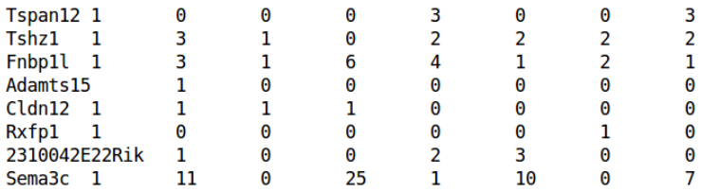
What does scRNA-seq data actually look like?
Output is a count matrix with genes as rows and cells as columns
~100-10^6 cells
~10000-40000 genes
Lots of zeros due to dropout or no expression
Variable total counts across cells – cell specific bias
Variable counts per gene – part biological, part technical
Be aware of the seemingly unsolvable issue of inconsistent gene annotation
and always use unique identifiers such as ensemble or entrez IDs!
Slide adapted from Single-cell Analysis Workshop by Aaron Lun, CRUK Cambridge Institute

Slide 9
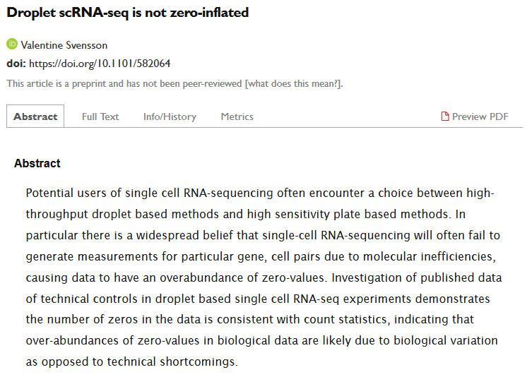

Slide 10

Performing a basic analysis of scRNA-seq data in R
Starting from a count matrix:
Data inspection
Quality control on cells and genes
Normalization and modeling of technical noise
Identification of variable genes
Dimensionality reduction
Clustering
Biological interpretation

Slide 11
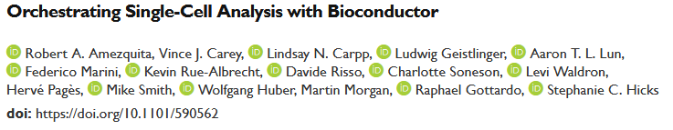
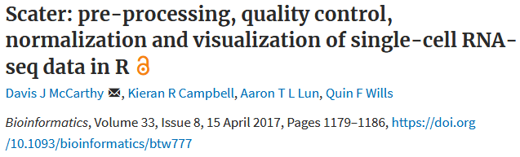
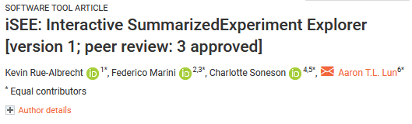
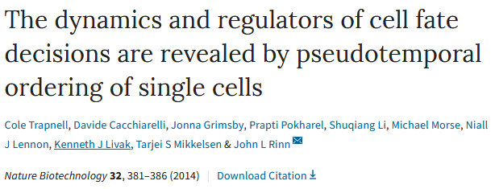

But there are plenty of alternatives:
Monocle

Slide 12





Where can I get public data?
https://www.ncbi.nlm.nih.gov/geo/
https://support.10xgenomics.com/single-cell-gene-expression/datasets/
https://portals.broadinstitute.org/single_cell
https://preview.data.humancellatlas.org/
http://jinglebells.bgu.ac.il/
….

Slide 13


Slide 14
Are you all ready to start?
R and R studio installed?
rmarkdown installed?
Packages installed?
Github repository downloaded and unzipped?
Data directory unzipped?
tutorial_scRNAseq.Rmd open in R studio?

Slide 15
Data inspection
How many cell barcodes do we find?
How many genes did we detect in the cells?
What is the percentage of 0 in the data?
Which gene types are present in the data set?
Which are the genes with the highest expression?

Slide 16

20 min
Hands-on experience part 1.
-> Chunk: Standard pre-processing workflow

Slide 17
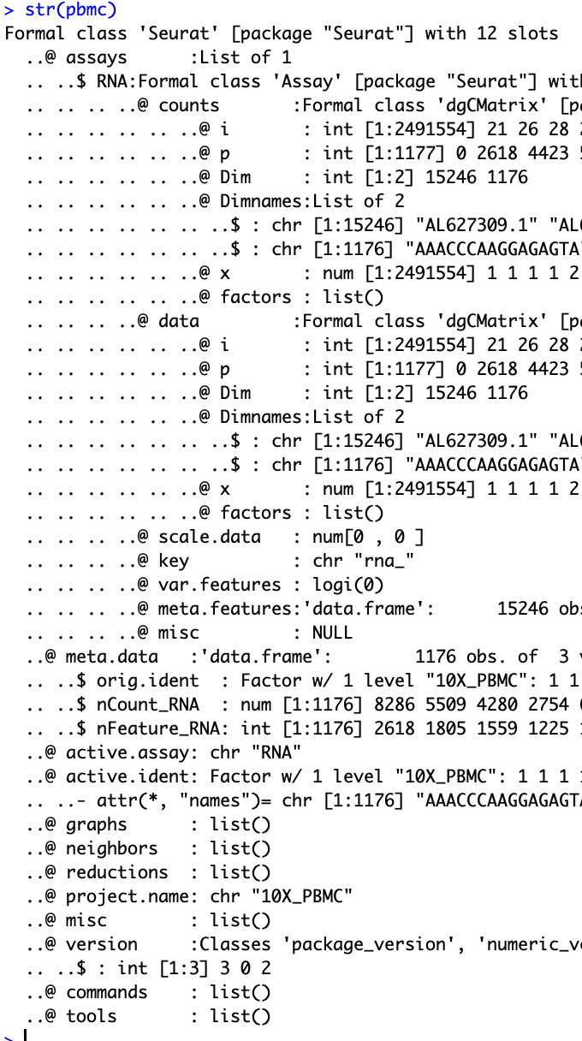
The Seurat Object
Each type of data has it‘s own slot
Facilitates streamlined analysis, easy execution of functions
e.g. raw counts:
pbmc@assay$counts
GetAssayData(object = pbmc, slot = 'counts')

Slide 18
Quality control on the cells
Low quality cells generated by:
Insufficient sequencing
Failed reverse transcription
Damaged and apoptotic cells
We use the following metrics to identify and remove low quality cells:
Total number of expressed genes or UMI per cell
Percentage of reads mapped to mitochondrial genes
Slide adapted from Single-cell Analysis Workshop by Aaron Lun, CRUK Cambridge Institute

Slide 19
Normalization
LogNormalize (default) → global scaling + log1p
Issues: overcorrection for weakly and moderately expressed genes and eventually undernormalization of highly expressed genes
Different numbers in total counts as a biological effect
SCtransform
Pooling information across genes with similar abundances
→ Available as part of the seurat pipeline
Replaces NormalizeData, ScaleData, and FindVariableFeatures
SCnorm
Quantile regression to estimate the dependence of transcript expression on sequencing depth for every gene
→ R package SCnorm

Slide 20
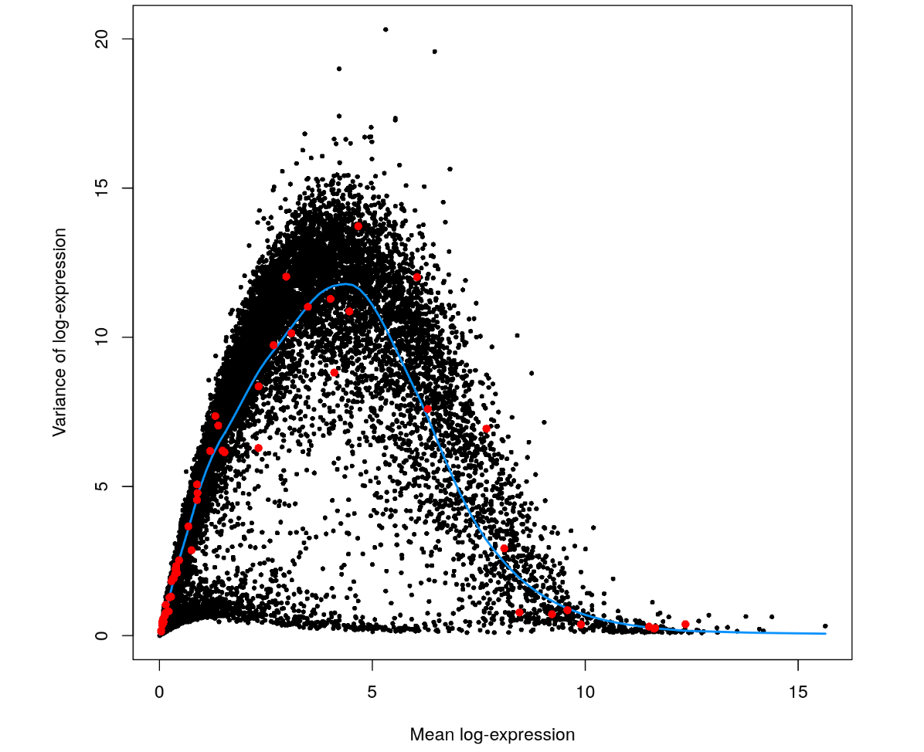
Selection of variable genes
Goal: identify genes that show a high overall variance / are informative Problem: If you would only look for the variance in the log-normalized data, then the variance is highly dependent on the mean
Variance stabilization
Seurat methods:
vst (default)
Mean.var.plot
dispersion
https://bioconductor.org/packages/release/workflows/vignettes/simpleSingleCell/inst/doc/var.html
Notes:
These genes are interesting as they drive differences in the expression profiles between cells, and should be prioritized for further investigation
vst: First, fits a line to the relationship of log(variance) and log(mean) using local polynomial regression (loess). Then standardizes the feature values using the observed mean and expected variance (given by the fitted line). Feature variance is then calculated on the standardized values after clipping to a maximum (see clip.max parameter).
mean.var.plot (mvp): First, uses a function to calculate average expression (mean.function) and dispersion (dispersion.function) for each feature. Next, divides features into num.bin (deafult 20) bins based on their average expression, and calculates z-scores for dispersion within each bin. The purpose of this is to identify variable features while controlling for the strong relationship between variability and average expression.
dispersion (disp): selects the genes with the highest dispersion values

Slide 21
Scaling & regression of batch effects
Batch effect regression: Linear modelling of potentially confounding variables → regression against that feature
Scaling: mean of 0 and standard deviation of 1
Used for dimensionality reduction and clustering
http://stanstrup.github.io/heatmaps.html
Notes:
Scales and centers features in the dataset:
Center = T : divide each gene by it’s average value
Scale = T: divide by standard deviation → mean of 0 and
If variables are provided in vars.to.regress, they are individually regressed against each feautre, and the resulting residuals are then scaled and centered.

Slide 22
Summary Part 2
Creating the Seurat Object
QC Plots & Filtering
Normalization
Selecting variable genes
Scaling & regression of batch effects

Slide 23
30 min
Hands-on experience part 2.
-> Chunk: Perform dimensionality reduction

Slide 24
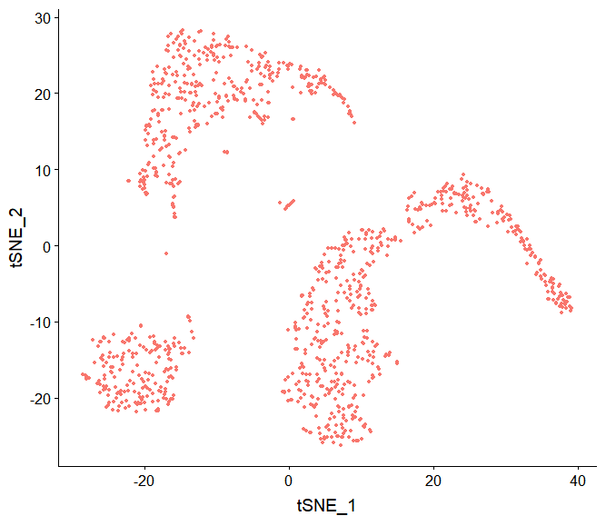
Dimensionality reduction
15246 genes
2000 variable genes
10 principal components

Slide 25
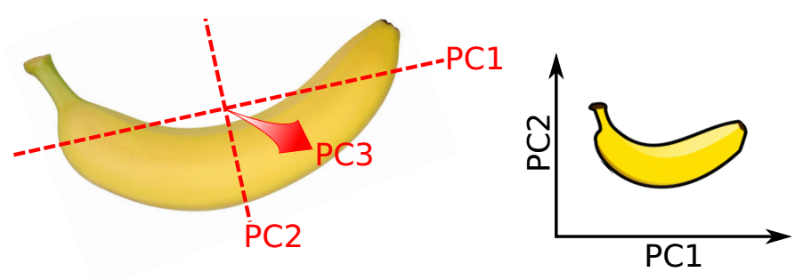
Dimensionality reduction with PCA
Identifies axes of maximal variance in high-dimensional data
Each subsequent principle component explains less variance
Use the first few PCs as a “summary” of the relevant variance in the data
Speed up downstream analyses by reducing dimensionality
Focus on biology, remove random noise in later PCs
https://www.youtube.com/watch?v=FgakZw6K1QQ
Slide adapted from Single-cell Analysis Workshop by Aaron Lun, CRUK Cambridge Institute

Slide 26
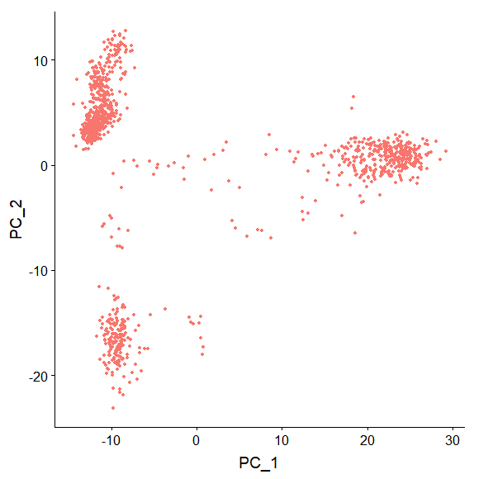
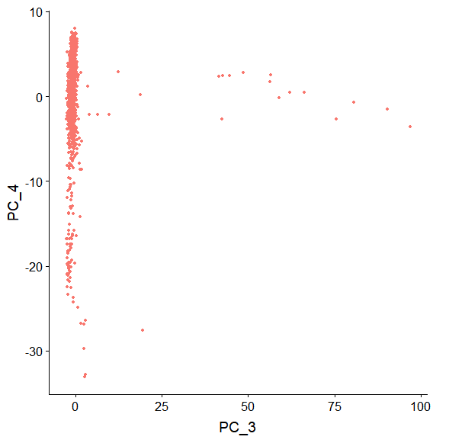
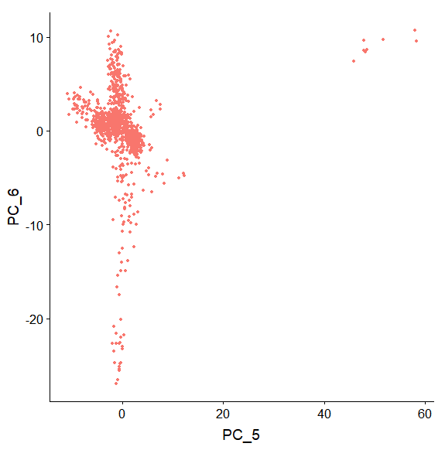
Visualization with PCA
The first PCs can be directly used for visualization:
Simple and efficient, but limited resolution of complex structure!
Slide adapted from Single-cell Analysis Workshop by Aaron Lun, CRUK Cambridge Institute

Slide 27
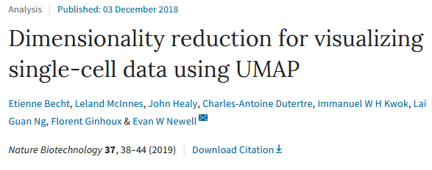
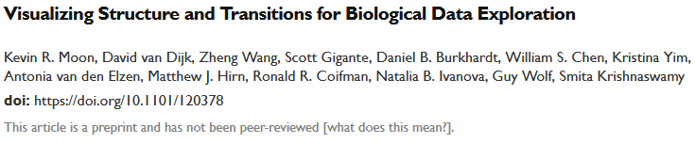
Visualization with t-SNE
T-distributed Stochastic Neighbor Embedding (t-SNE) is a machine learning algorithm for visualization. It is a nonlinear dimensionality reduction technique well-suited for embedding high-dimensional data for visualization in a low-dimensional space of two or three dimensions. Specifically, it models each high-dimensional object by a two- or three-dimensional point in such a way that similar objects are modeled by nearby points and dissimilar objects are modeled by distant points with high probability.
Finds a two-dimensional representation of high-dimensional data
Preserves distances to neighboring cells
Slide adapted from Single-cell Analysis Workshop by Aaron Lun, CRUK Cambridge Institute

Slide 28
30 min
Hands-on experience part 3.
-> Chunk: Clustering

Slide 29
Clustering methods and differential expression
Seurat package

Slide 30
Clustering methods
Louvain algorithm
Louvain algorithm with multilevel refinement
SLM algorithm
Leiden algorithm
PCA
Diffusion maps
LDA
Neural networks

Slide 31
Clustering methods (Seurat)

Slide 32
Clustering methods (Seurat)
Louvain algorithm FindClusters()
Each node on the network is assigned to its own community (singleton) then local moving heuristic to improve community structure (max modularity), re-do in reduce model 2., reduce model 3. until it cannot be reduced no longer
Identifies clusters by a shared nearest neighbour (SNN)
Calculate k-nearest neighbours
SNN graph
Optimization of modularity function
Clusters

Slide 33
Clustering methods (Seurat)
Louvain algorithm FindClusters()

Slide 34
Clustering methods (Seurat)
FindCluster()
Louvain algorithm
Louvain algorithm with multilevel refinement
SLM algorithm
Leiden algorithm

Slide 35
Differential expression
Presto
Notes:
Wilcoxon rank sum test

Slide 36
Differential expression
Differential expression between clusters (FindMarkers())
One cluster against all other clusters
One cluster against two other clusters
.
.

Slide 37
Assigned cell type
By known marker genes
Model based approaches
SingleR (immune cells)
cellassign
Notes:
Subjective marker genes
Unbiased cell typer reconition

Slide 38
cellassign package
Notes:
Subjective marker genes
Unbiased cell typer reconition

Slide 39
30 min
Hands-on experience part 4.

Slide 40

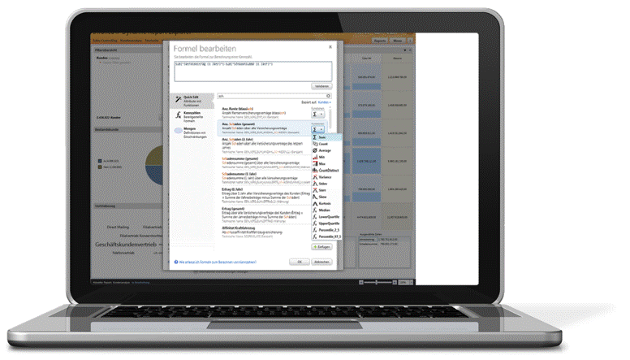

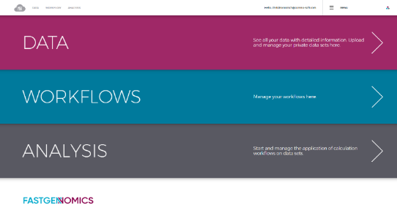
FASTGenomics
An analytical ecosystem for single-cell RNA sequencing data
Data Sharing
Data Exploration
Publication
GDPR compliant
Data Sharing
Data Exploration
Publication
Share your own data sets with meta data and full documentation with colleagues. FASTGenomics provides you with templates for sharing contracts and a secure cloud infra-structure.
Start standard analyses in the cloud. Explore existing public or your own private data sets with default analytical workflows for subtype discovery or differenti-ation analysis – or write your on analysis tools.
Showcase your results in fast and interactive way using visualizations and a fully automatic method documentation to capture your target audience with detailed insights to your research.
Register at: www.fastgenomics.org
Contact us: contact@fastgenomics.org
Notes:
Teilen teilen teilen!!!

Slide 41
Why single-cell analyses?
What if a disease is caused by the local infiltration or loss of a specific cell type or a specific alteration of a cellular subset?
Bulk RNA-seq
Identification on single-cell level
allows targeted evaluation in bulk
Averaging the expression over a highly heterogeneous cell population leads to a loss of cell-type specific information and can masks specific alterations.
Preserving cell-type identity allows assessment of cellular heterogeneity and the identification of cell-type specific alterations of gene expression.

Slide 42
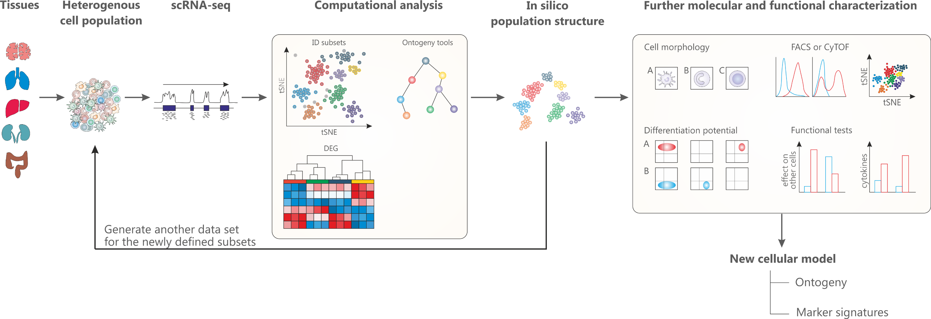
The power of single-cell RNA-seq
Schultze & Aschenbrenner, Sem Cell Dev Biol, 2018
Ginhoux*, Schultze*, et al. Nature Immunology, 2016
Single-cell RNA sequencing can reveal complex and rare cell populations, uncover regulatory relationships between genes, and track the trajectories of distinct cell lineages in development.

Slide 43
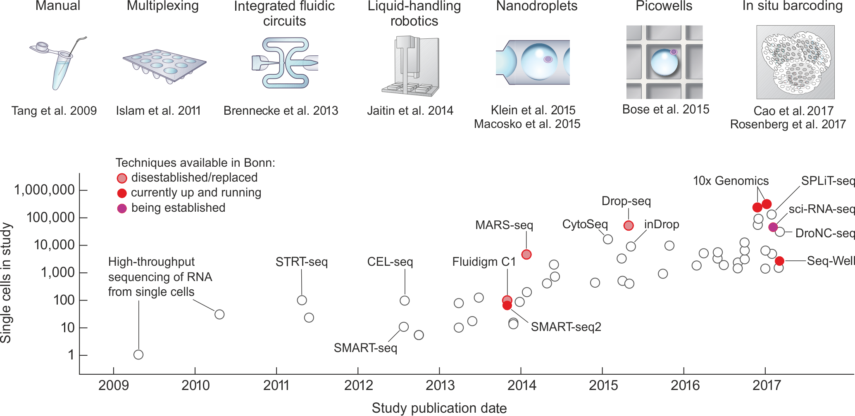
Evolution of single-cell RNA-seq methods
Modified from Exponential scaling of single-cell RNA-seq in the last decade, Svennson et al. 2017 arXiv

Slide 44
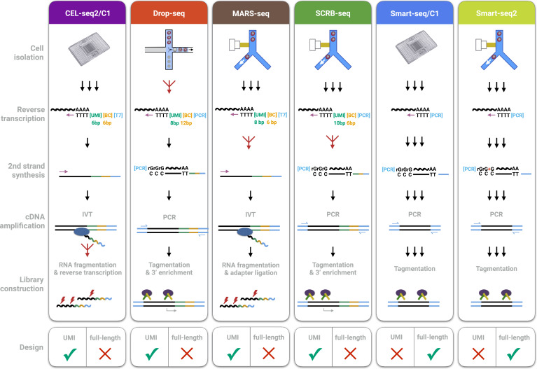
3’ vs full length libraries
Comparative Analysis of Single-Cell RNA Sequencing Methods, Ziegenhain et al., Molecular Cell 2017

